Slide 1
Refactoring for Testability
(or how I learned to stop worrying and love failing tests)
Presented by Aaron Evans <aarone@one-shore.com>

Slide 2
Refactoring for Testability
What is refactoring?
What is testability?
How do we do it?
Notes:
“Refactoring is a disciplined technique for restructuring an existing body of code, altering its internal structure without changing its external behavior” – Martin Fowler

Slide 3
Refactoring for Testability
Why refactor?
My code is good

Slide 4
Refactoring for Testability
Why refactor?
The only constant is change

Slide 5
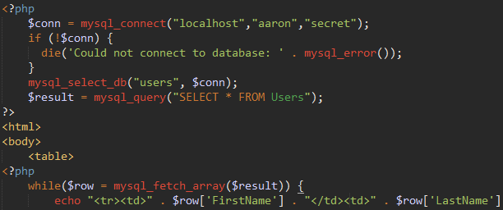
Refactoring for Testability
User Interface Code
Don’t hard code configuration
Handle errors gracefully
Don’t expose other layers
Encapsulate implementation details
Don’t tie your code to vendor
Use meaningful variable names
Separate business logic from display logic

Slide 6
Refactoring for Testability
Refactoring the UI
Yes, Virginia, there really is display logic
ID tags
Individually testable components
Maintainable UI tests

Slide 7
Refactoring for Testability
Push testing down the stack
Reduce brittle UI tests
Run tests faster
Isolate the system under test
Think about code as individual components

Slide 8
Refactoring for Testability
SOLID
Single Responsibility Principle
Open / Closed Principle
Liskov Substitution Principle
Liskov Substitution Principle
Interface Segregation Principle
Dependency Inversion Principle

Slide 9
Refactoring for Testability
Refactoring Strategies
Extract
Consolidate
Change
Move
Encapsulate
Substitute
Hide
Expose
Pull up
Push down
http://www.refactoring.com/catalog/
Notes:
Refactoring.com is maintainted by Martin Fowler, who literally wrote the book on the subject.

Slide 10
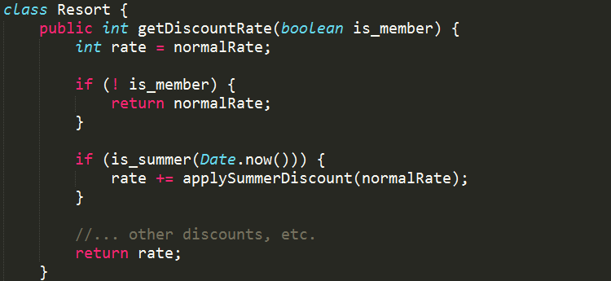
Refactoring for Testability
This…
Becomes…
Implementation
Notes:
Refactoring.com is maintainted by Martin Fowler, who literally wrote the book on the subject.

Slide 11
Refactoring for Testability
Adding Layers of Abstraction
Indirection
Reusability
Composition over Inheritance
Database Abstraction Layer
ORM
Domain Model
Business Logic
Notes:
“Any problem in computer science can be solved with another layer of indirection” David Wheeler (inventor of subroutines)

Slide 12
Refactoring for Testability
Simplifying Interfaces
Exposing Functionality

Slide 13
Refactoring for Testability
Decoupling
Presentation and Business Logic
Persistence and Domain Objects
Interface from Implementation

Slide 14
Refactoring for Testability
Dependency Injection
No news is good news
No framework is necessary
Factory pattern
Constructors / Setters / Builders
Loose Coupling

Slide 15
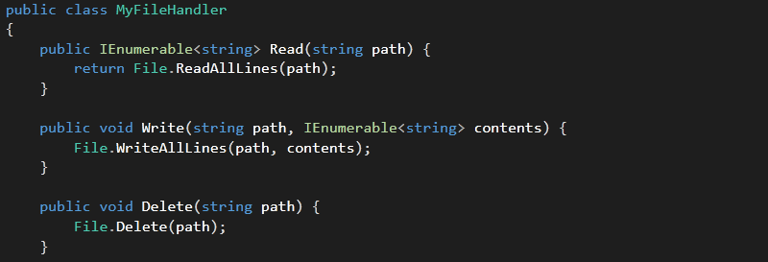
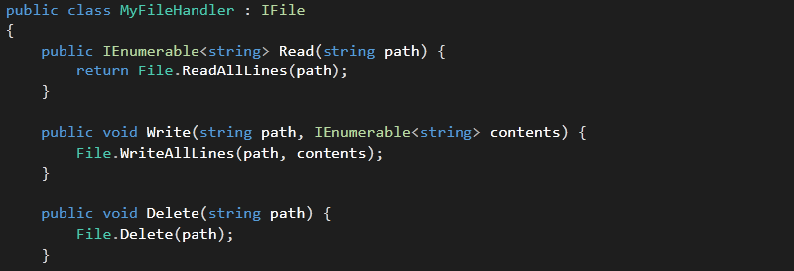
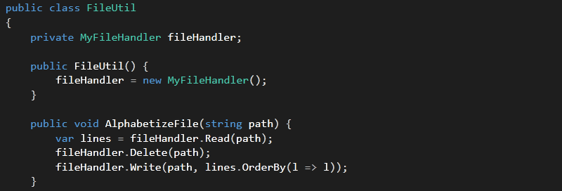
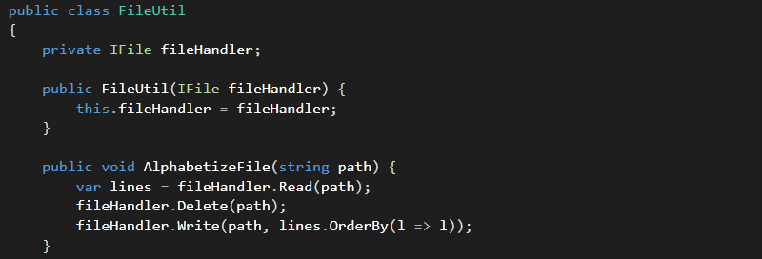
Refactoring for Testability
Extract Interface
Inject Dependency

Slide 16
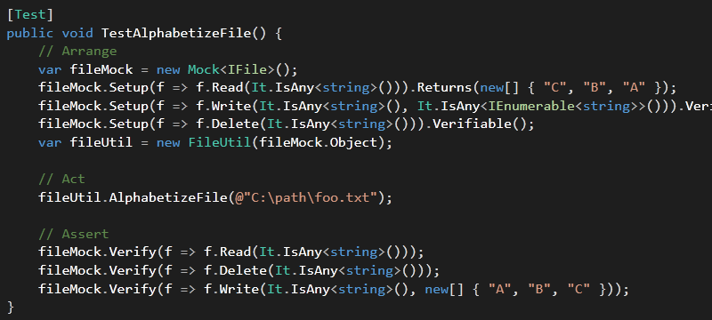
Refactoring for Testability
Use Mocks
Single Responsibility

Slide 17
Refactoring for Testability

Slide 18
Refactoring for Testability
Reduce Dependencies

Slide 19
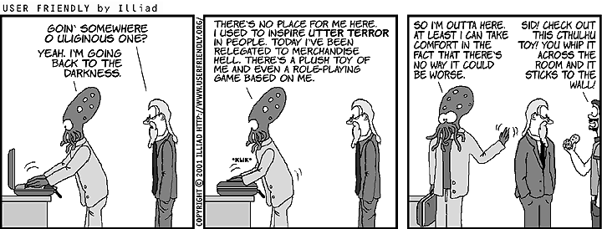
Refactoring for Testability
Coding in business terms
Common domain language
Acceptance criteria
BDD frameworks – RSPEC, Specflow, JBehave

Slide 20
Questions?
Thanks...
Aaron Evans <aarone@one-shore.com>

